Slide 1
Chapter 1-2
Course Implementation
计算机系统概论
Introduction to Computing Systems
（CS1002A.02）
苗付友
mfy@ustc.edu.cn
2025 Fall
计算机科学与技术学院
School of Computer Science and Technology

Slide 2
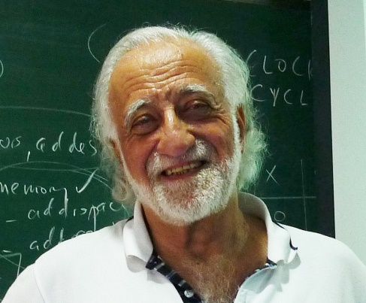
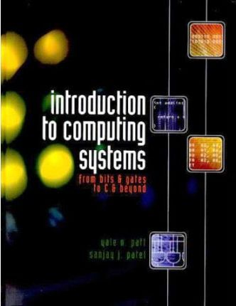
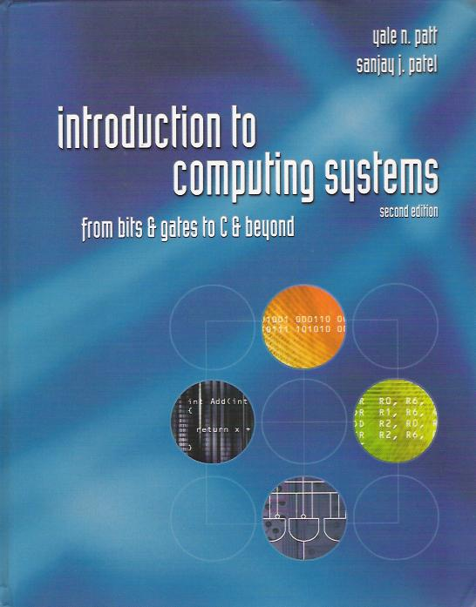
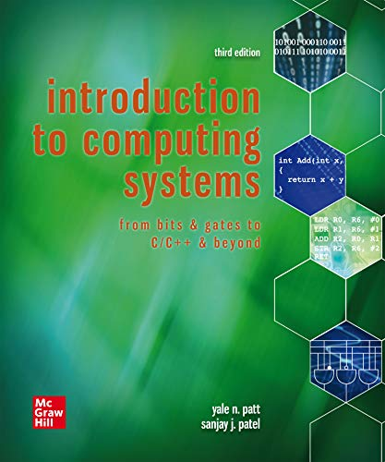
Text Book
Introduction to computer architecture(ISA)
  How is data represented?
  What are the pieces of a computer?
  How do computers work?
Programming
  How do I "talk" directly to the machine?-Assembly language
  How do I program in “C”?-high level language(HLL)
Computer systems and computation
  How do simple HW/SW elements come together to realize complex computations?
Introduction to Computing Systems: from bits and gates to C/C++and beyond(3nd edition),
Yale N. Patt and Sanjay J. Patel， September 2019, McGraw-Hill Higher Education

Slide 3
Text Book Components
Part 1: Hardware(Chapter 1-4)
  Representing data, transistors, gates, digital logic structures
  von Neumann machine model
Part 2: Software: Assembly language(Chapter 5-10)
  Instructions, (structured) programming, input/output, relationship to hardware
Part 3: Software: C programming(Chapter11-19), selected
  Syntax, operators, control structures, functions, pointers, recursion, data structures, relationship to assembly language
  Assume already familiar with programming (C)

Slide 4
This Course Focused on
Chapt 2 Bits and Bytes
  How do we represent information using electrical signals?
Chapt 3 Digital Logic
  How do we build circuits to process information?
Chapt 4, 5, 6 Computer Machine Model, Processor and Instruction Set
  How do we build a processor out of logic elements?
  What operations (instructions) will we implement?
Chapt 7 Assembly Language Programming
  How do we use processor instructions to implement algorithms?
  How do we write modular, reusable code? (subroutines)
Chapt 8,9,10 I/O, Traps, and Interrupts
  How does processor communicate with outside world?
Chapt 11, C Implemention related to Hardware

Slide 5
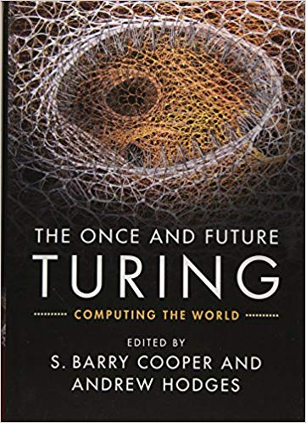
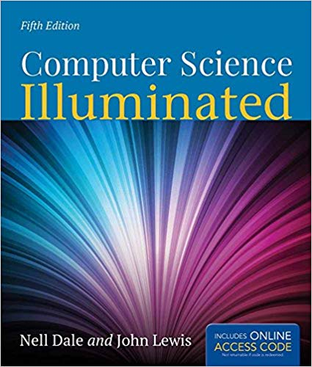
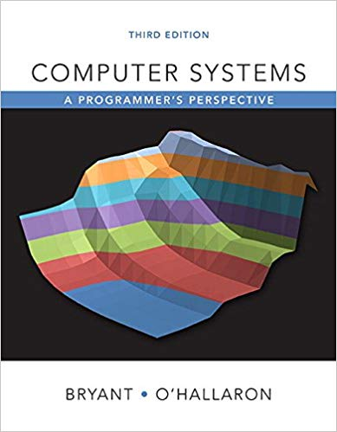
Other Reference Text Books
3
4
1
2
Introduction to Computing Systems: from bits and gates to C/C++ and beyond(3nd edition),
Yale N. Patt and Sanjay J. Patel， June 2019, McGraw-Hill Higher Education
Computer Science Illuminated(5th Edition) ,
D. M. Harris, S. L. Harris, Morgan Kaufmann, San Francisco, 2007
Computer Systems: A Programmer‘s Perspective (3rd Edition) ，
Randal E. Bryant, David R. O’Hallaron，Pearson Education Inc.，2016
The Once and Future Turing: Computing the World （1st Edition），
S. Barry Cooper, Andrew Hodges，Cambridge University Press，2016

Slide 6
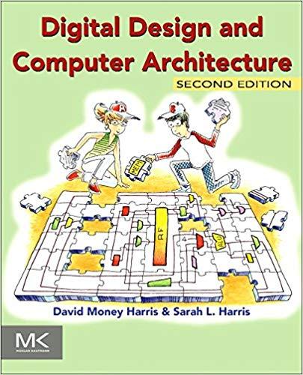
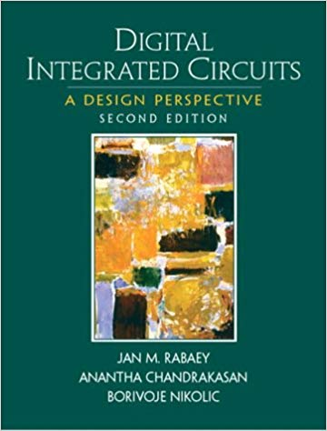
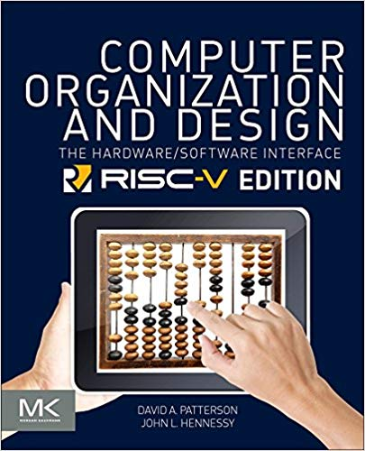
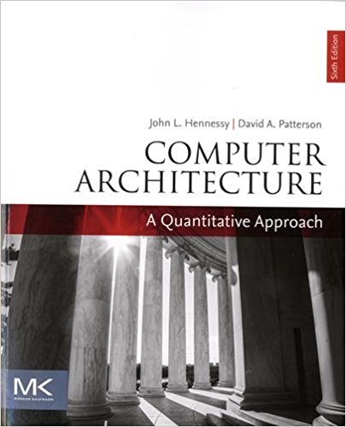
Other Reference Text Books
₅
₆
₇
₈
Digital Design and Computer Architecture（2nd Edition），
David Harris Sarah Harris，p712, Morgan Kaufmann，24th July 2012
Digital Integrated Circuits: A Design Perspective (2nd Edition),
Jan M. Rabaey，Anantha Chandrakasan, Borivoje, Prentice-Hall, Inc，Nikolic,Jan 3, 2003
Computer Organization and Design: The Hardware/Software Interface，
David A Patterson, John L. Hennessy, 5th edition. Morgan Kaufmann Publishers, Inc.，2017
Computer Architecture: A Quantitative Approach，
John L. Hennessy and David A. Patterson， The Morgan Kaufmann，Dec 7, 2017

Slide 7
Background/Prerequisites
Requirement
  background in programming(C)
  Assume you can program/debug in C
7

Slide 8
Class Organization
Labs – LC-3 Simulator /Assembler
  All labs start after two weeks
1Midterms + 1 Final
Location: 3C101
Date:
  September 2 - December 30
Time
  4(3,4,5): 9:45-12:10
60 hours+40hours，3+1credit

Slide 9
课堂教学模式：基于讲义（TBL）& 基于案例（CBL）
Lectures
  Will not simply “cover” the material
  Will focus on the “hard stuff”
  Will not stand alone, instead build on reading
Part 1: Hardware(Chapter 1-4)
  Representing data, transistors, gates, digital logic structures
  von Neumann machine model
Part 2: Software: Assembly language(Chapter 5-10)
  Instructions, (structured) programming, input/output, relationship to hardware
Part 3: Software:C programming(Chapter11-19), selected
  Syntax, operators, control structures, functions, pointers,recursion, data structures, relationship to assembly language
  Assume already familiar with programming (C)

Slide 10
实践教学模式：基于资源（RBL）
LC-3/RISC-V Simulator/Assembler
Labs Assignments：Simple exercises
  Programming Assignments
    Programming LC3 Assignments1: Programming In machine language
    Programming Assignments2~5:Programming In LC3 assembly language
    Programming Assignments6:Assignments2~5:Programming In C
Course Projects：Challenging projects
  LC-3 Simulator/Assembler Design(Encouraged! Extra 5 points）

Slide 11
Homework Assignments
Problem Sets
  Problem solving
  Complete before each due date
  Can work ahead
  Submit and complete assignment by yourself to get points (whether correct or wrong)
  Do not copy

